Slide 1

Intermediate Science

Slide 2

Mrs Angela Romo
California Clear Credential
Masters of Art in Elementary Education

Slide 3

Grade 4: Tuesday & Thursday
10:15-11:15
Grade 3: Monday & Wednesday- 11:00-12:00

Slide 4

Be Prepared
Have all your materials with you!
Follow Directions!
Complete all assignments when due!
Always Do Your Best!

Slide 5

1.Respect Yourself!
2. Respect Others!
3. Respect Your School!

Slide 6

Grades will be based on the Archdiocese Guidelines
95-100=A
93-94=A-
90-92=B+
87-89=B
84-85=B-
80-84=C+

Slide 7

Students will have homework-some more than others depending on how well they use their time during lab. Some labs might take us two weeks so there is no set schedule for the vocabulary or homework. Students must come to lab with definition& illustration in their science notebooks. Missing labs must be completed at “Make Up Wednesday” or at home.I do not accept late work.

Slide 8

Absent
If a student is absent it is their responsibility to check the MIA board for their work. I will be having “Work It Wednesday”-students who need to make up work must come at recess, lunch and/or after school until 4:00 to make up their assignments.
They are given one day per day absent to make up missed work.

Slide 9

We will be following the Next Generation Science Standards. The link for each grade is on my website. We will be starting the year with Physical Science.

Slide 10

Science
Grade 4-
Unit 1- Earth’s Changing Surface
Project: Earthquakes- will be designing and building an apartment block in an earthquake prone area
Unit 2-Energy-
Project: Rube Goldberg Machine- Can you create a chain reaction?
Unit 3-Waves-
Project:1. Rock Star Challenge
2.Shadow Puppets
3.Engineering Task- Design your own form of communication
Unit 4- Structures & Processes
Project: Animal Superpower

Slide 11

Science
Grade 3
Unit 1- Physical Science-Force, Interaction &Engineering
Project: Rube Goldberg- Build a chain reaction
Unit 2- Earth Science-Weather &Climate
Project-Build a new shelter to withstand extreme weather & a monthly weather log and oral report
Unit 3- Earth Science-Environmental Impact on Organisms
Unit 4-Life Cycles-Life Cycles & Traits

Slide 12
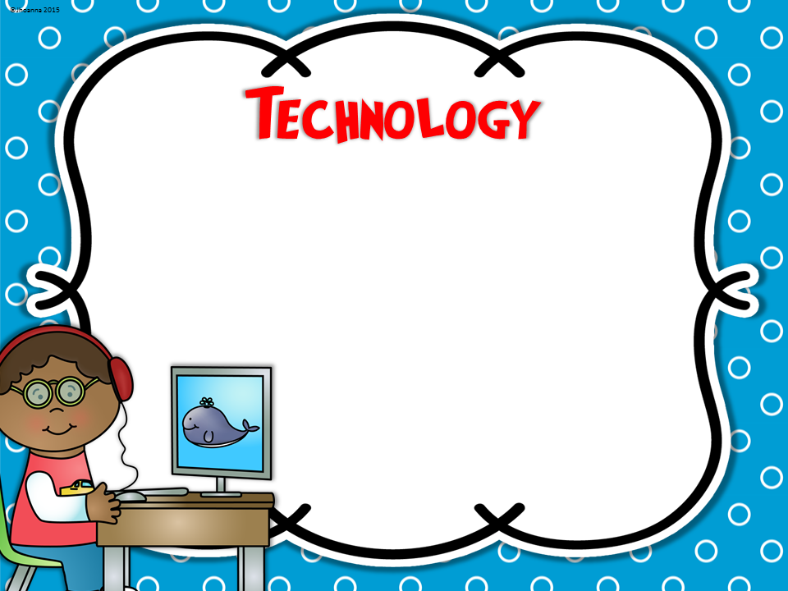
Students who have ipads make bring them to science lab. We will be using the Brain Pop App as well as many other science sites and activities. Please make sure your student has internet access at home as they will need to complete web assignments.

Slide 13

Students will all need Composition book and always have headphones. They will need to have glue sticks, scissors and crayons from their class supplies. They will also need post its and index cards. I will request supplies
as needed

Slide 14

Please sign up for Remind.com
Check website weekly-www.romoshive.weebly.com

